Slide 1
Cloud Computing and Big Data Machine Learning
Oxford University
Software Engineering Programme
July 2020

Slide 2
Contents
Definitions and terminology
The overall process
Main techniques
Algorithms and examples
Big Data Machine Learning
R and PMML
Spark MLLib
Introduction to the lab

Slide 3
Definition of Machine Learning
Algorithms that can learn from data

Slide 4
Definition of Machine Learning
Algorithms that can learn from data
Ok that was a circular definition ☺

Slide 5
Definition take 2
Algorithms that can analyse a set of data to find patterns and then make predictions when new data comes in

Slide 6
Uses of Machine Learning
Fraud Detection
Spam emails, fake reviews, credit card fraud
Personalization
Recommendations
Targeted Marketing
Predictive preferences, cross-selling
Content Classification
Document classification, sentiment analysis
Customer Support
Social media analysis
Many others

Slide 7
Learning phase
Labelled Data
Extraction of features
Learning
Model

Slide 8
Usage phase
Model
New Data
Algorithm
Label

Slide 9
Terminology
Sample
Some incoming data to be analysed
E.g. a JPG picture
Feature
Some quantifiable data from the sample
E.g. colour, height, width, pixel data, etc
Label
Some useful information about the sample that we wish to categorise:
E.g. looking at a picture this is a person
Model
The output of some learning algorithm
The parameterization of an algorithm that can be run against new data

Slide 10
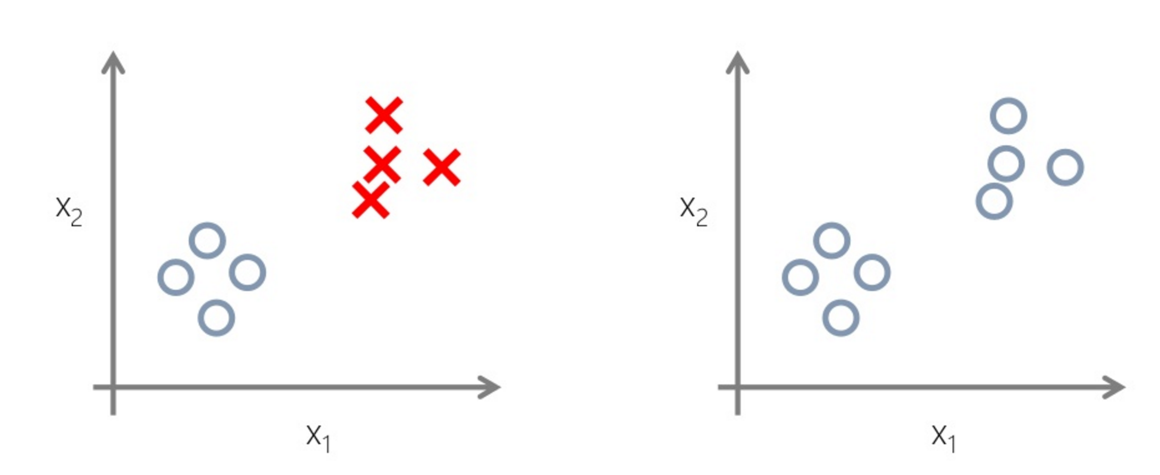
Supervised vs Unsupervised
Source: http://www.slideshare.net/damirdobric

Slide 11
Types of learning
Supervised
The required labels are known
Aiming to find an algorithm that correctly identifies these
Iterative exploration and refinement
Useful for prediction
Unsupervised
The labels are not known
The system identifies new classifications
Exploring the past, better understanding it
Reinforcement
Learning as you go
E.g. learning to play chess while playing chess

Slide 12
Types of machine learning
Classification
Regression / Prediction
Clustering
Recommendation and Collaborative Filtering
Frequent Pattern mining

Slide 13
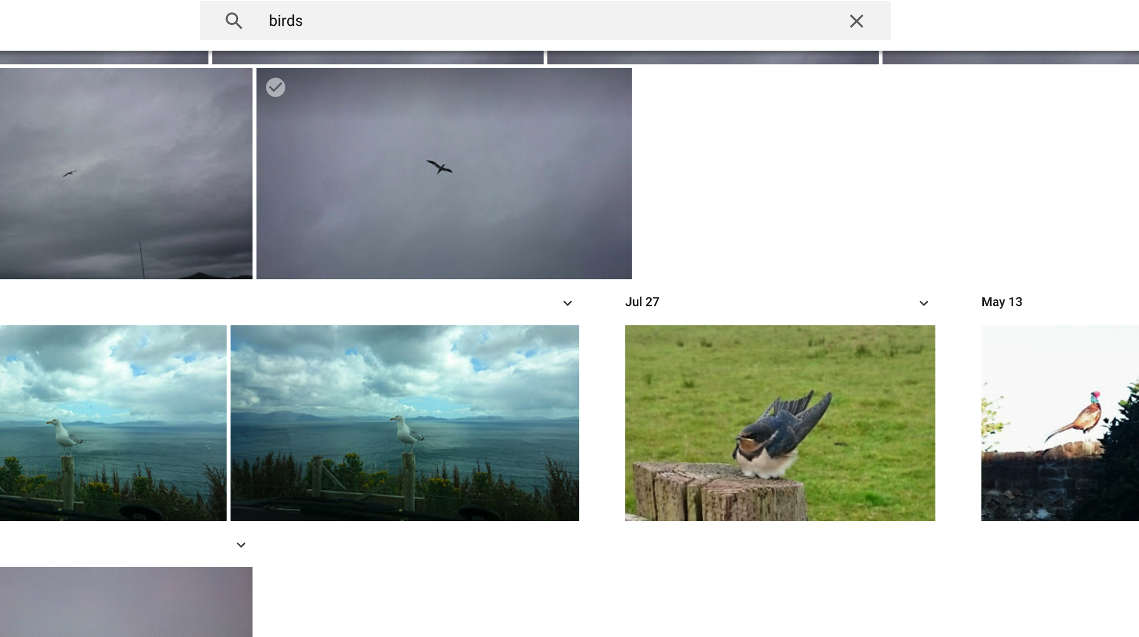
Classification

Slide 14
Classification
Identifying a class into which this sample fits
E.g. look at a picture and decide if it contains a bird
A key part of artificial intelligence
Also deeply useful for making sense of big data

Slide 15
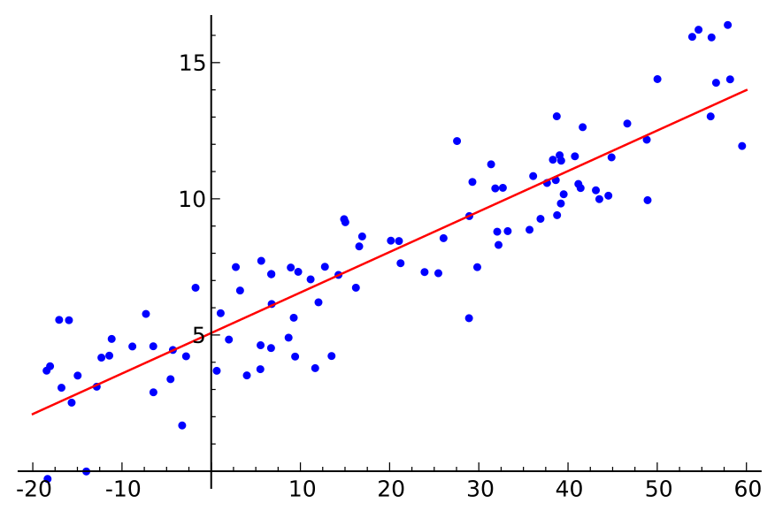
Regression
Applying a model based on previous data
Allows prediction of future state
Many statistical techniques

Slide 16
Regression vs Classification
Regression produces a real number or numbers
i.e. a continuously varying answer or answers
Classification identifies a set or element of a set
E.g. False, Blue, Person, High-Value Customer

Slide 17
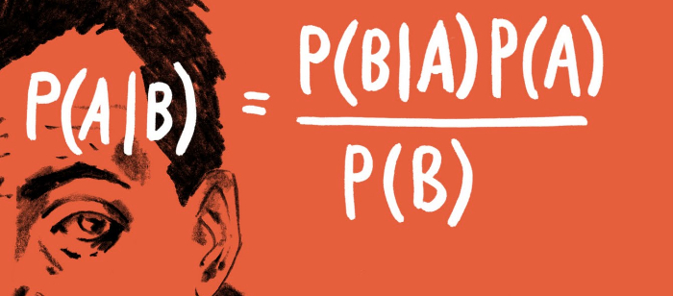
Bayes Theorem
P(A|B) is the probability of A given B
P(A) is the probability of A without regard to B

Slide 18
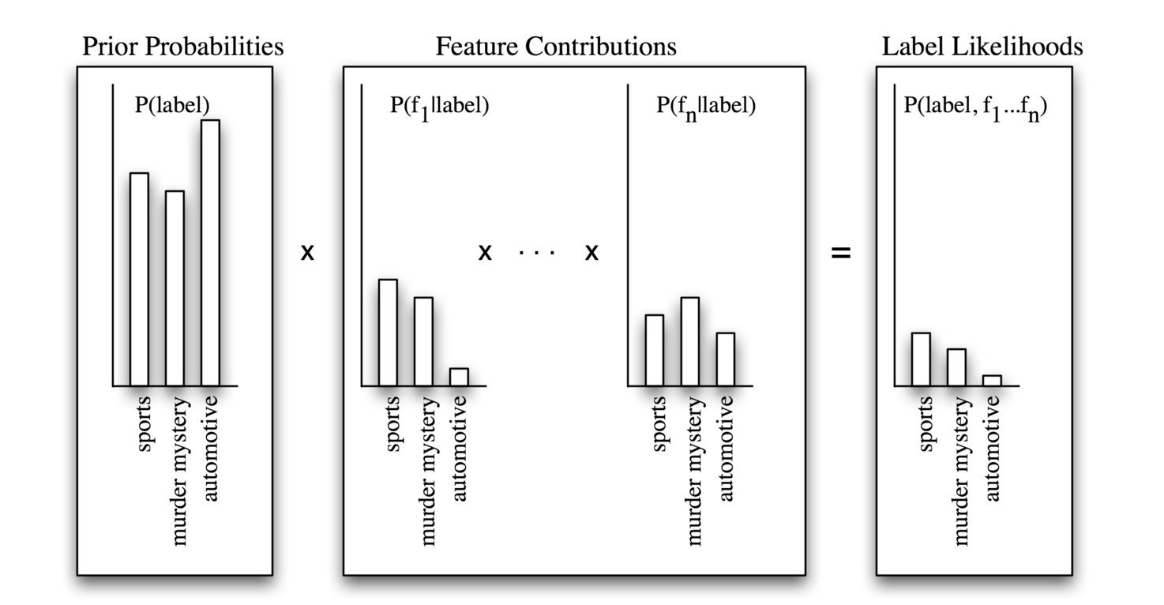
Classification Algorithms
Naïve Bayes

Slide 19
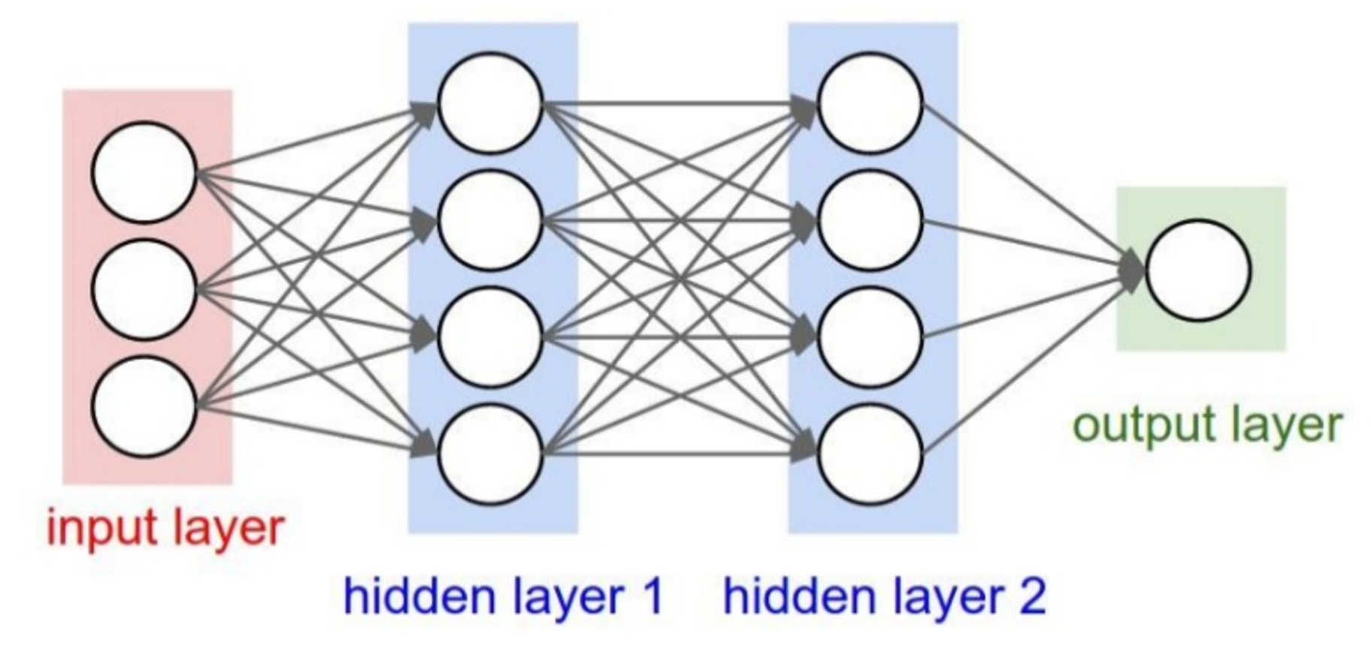
Deep Learning

Slide 20
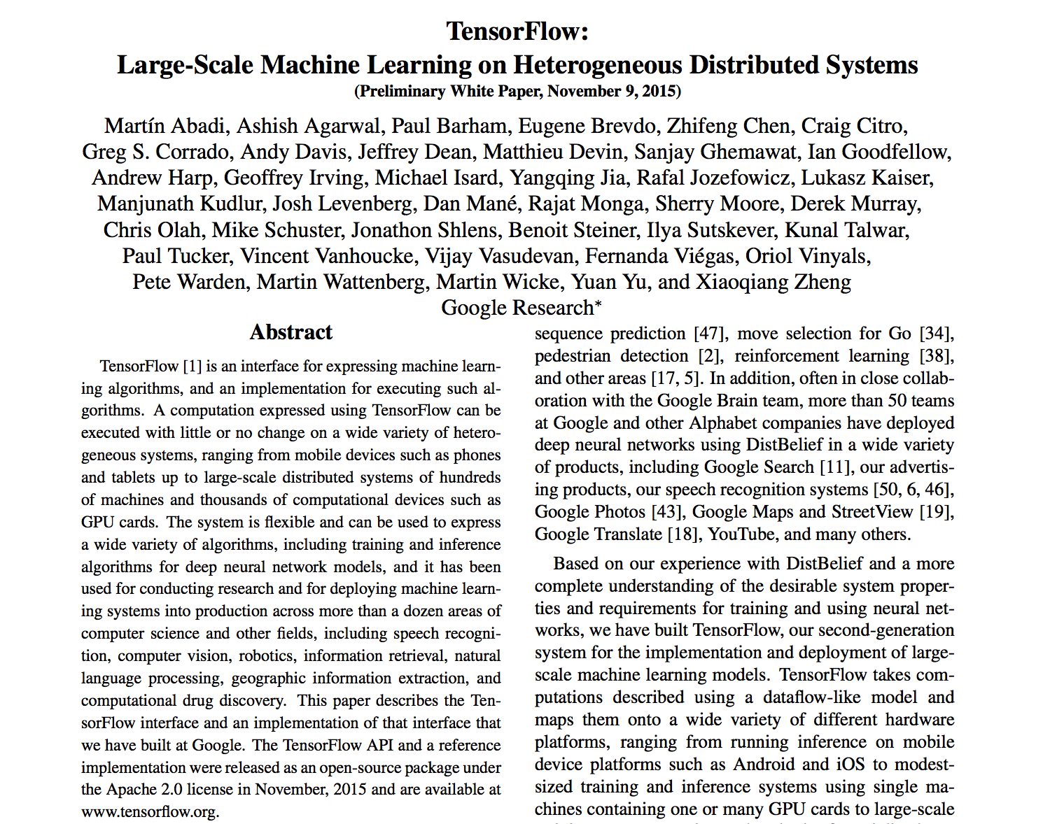
Google Tensor Flow

Slide 21
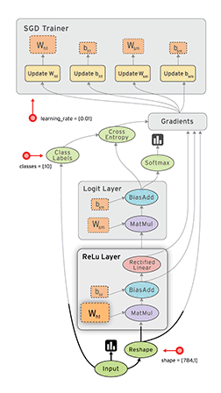
TensorFlow
Announced and open sourced in Nov 2015
Strong adoption in the meantime
CPU and GPU support with no coding changes
Neural networks plus arbitrary dataflows
www.tensorflow.org

Slide 22

Inspirobot.me

Slide 23
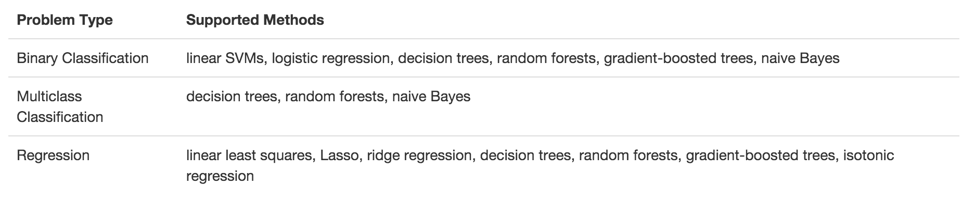
Spark MLLib’s algorithms

Slide 24
Clustering
Grouping items into clusters
Where items in a cluster are more similar to each other than to items in other clusters
Basically creating the classifications from the data rather than applying them a priori

Slide 25
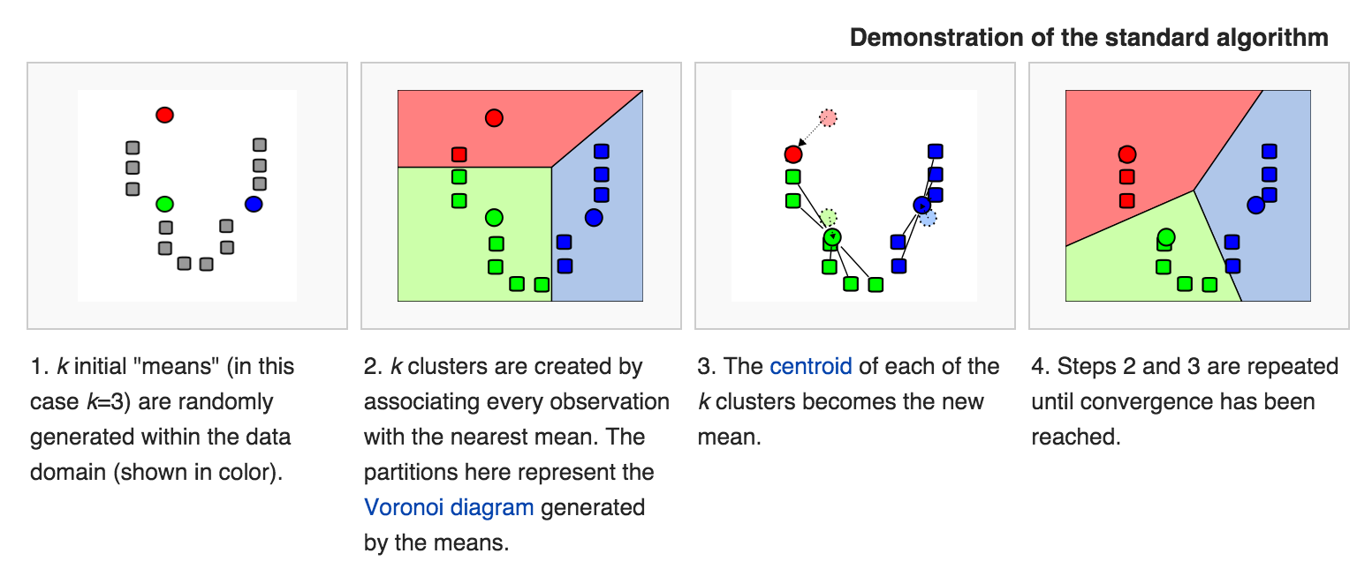
K-Means Clustering

Slide 26
MLLib’s clustering
K-means
Gaussian mixture
Power iteration clustering (PIC)
Latent Dirichlet allocation (LDA)
Streaming k-means

Slide 27
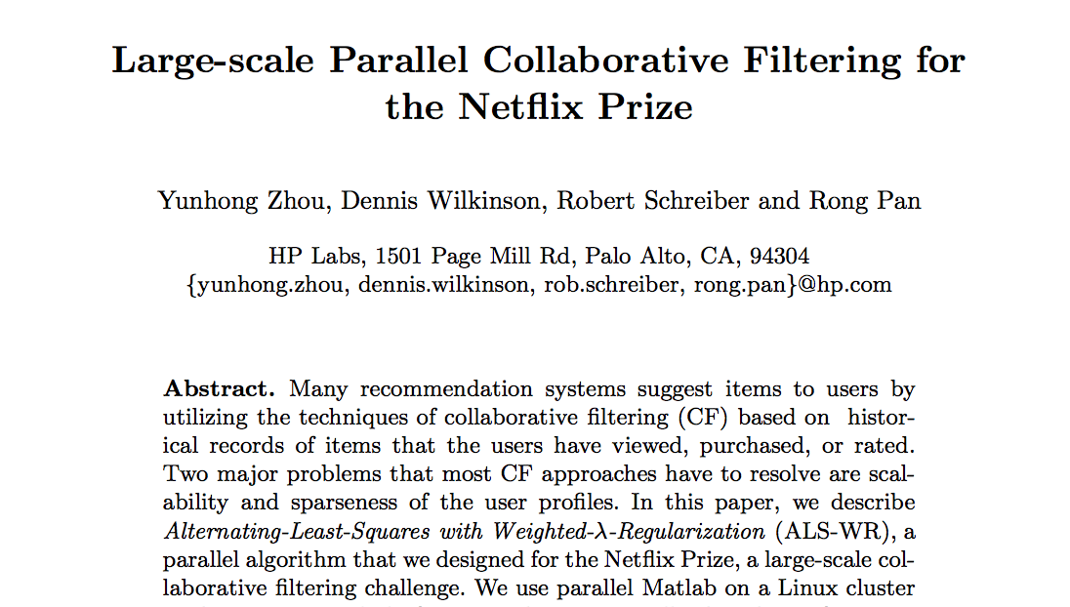
Recommendation and Collaborative Filtering
Given a user’s interaction with items, what else are they likely to prefer

Slide 28

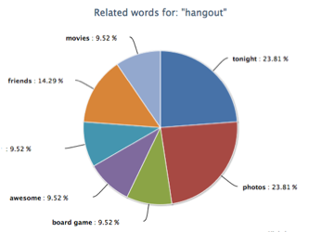
Frequent Pattern Mining

Slide 29
MLLib FPM
Frequent pattern mining
FP-growth
association rules
PrefixSpan

Slide 30
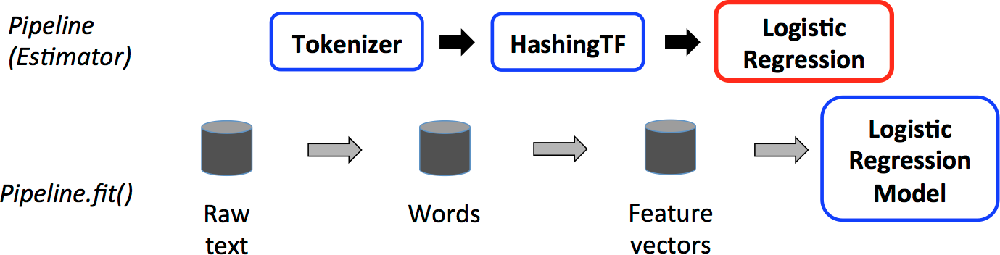
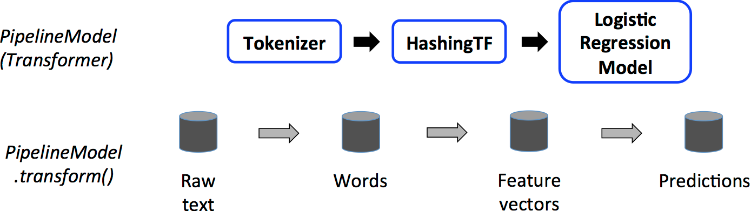
Spark MLLib Pipelines
TRAINING
USAGE

Slide 31
Big Data ML
Obviously we can learn more insights with more data
Many examples
Netflix competition
Google, Facebook, Twitter etc are all doing big data ML
Obviously we want the right algorithms:
E.g. Kmeans++ is a parallelizable version of Kmeans
MLLib and Mahout come pre-built with these

Slide 32
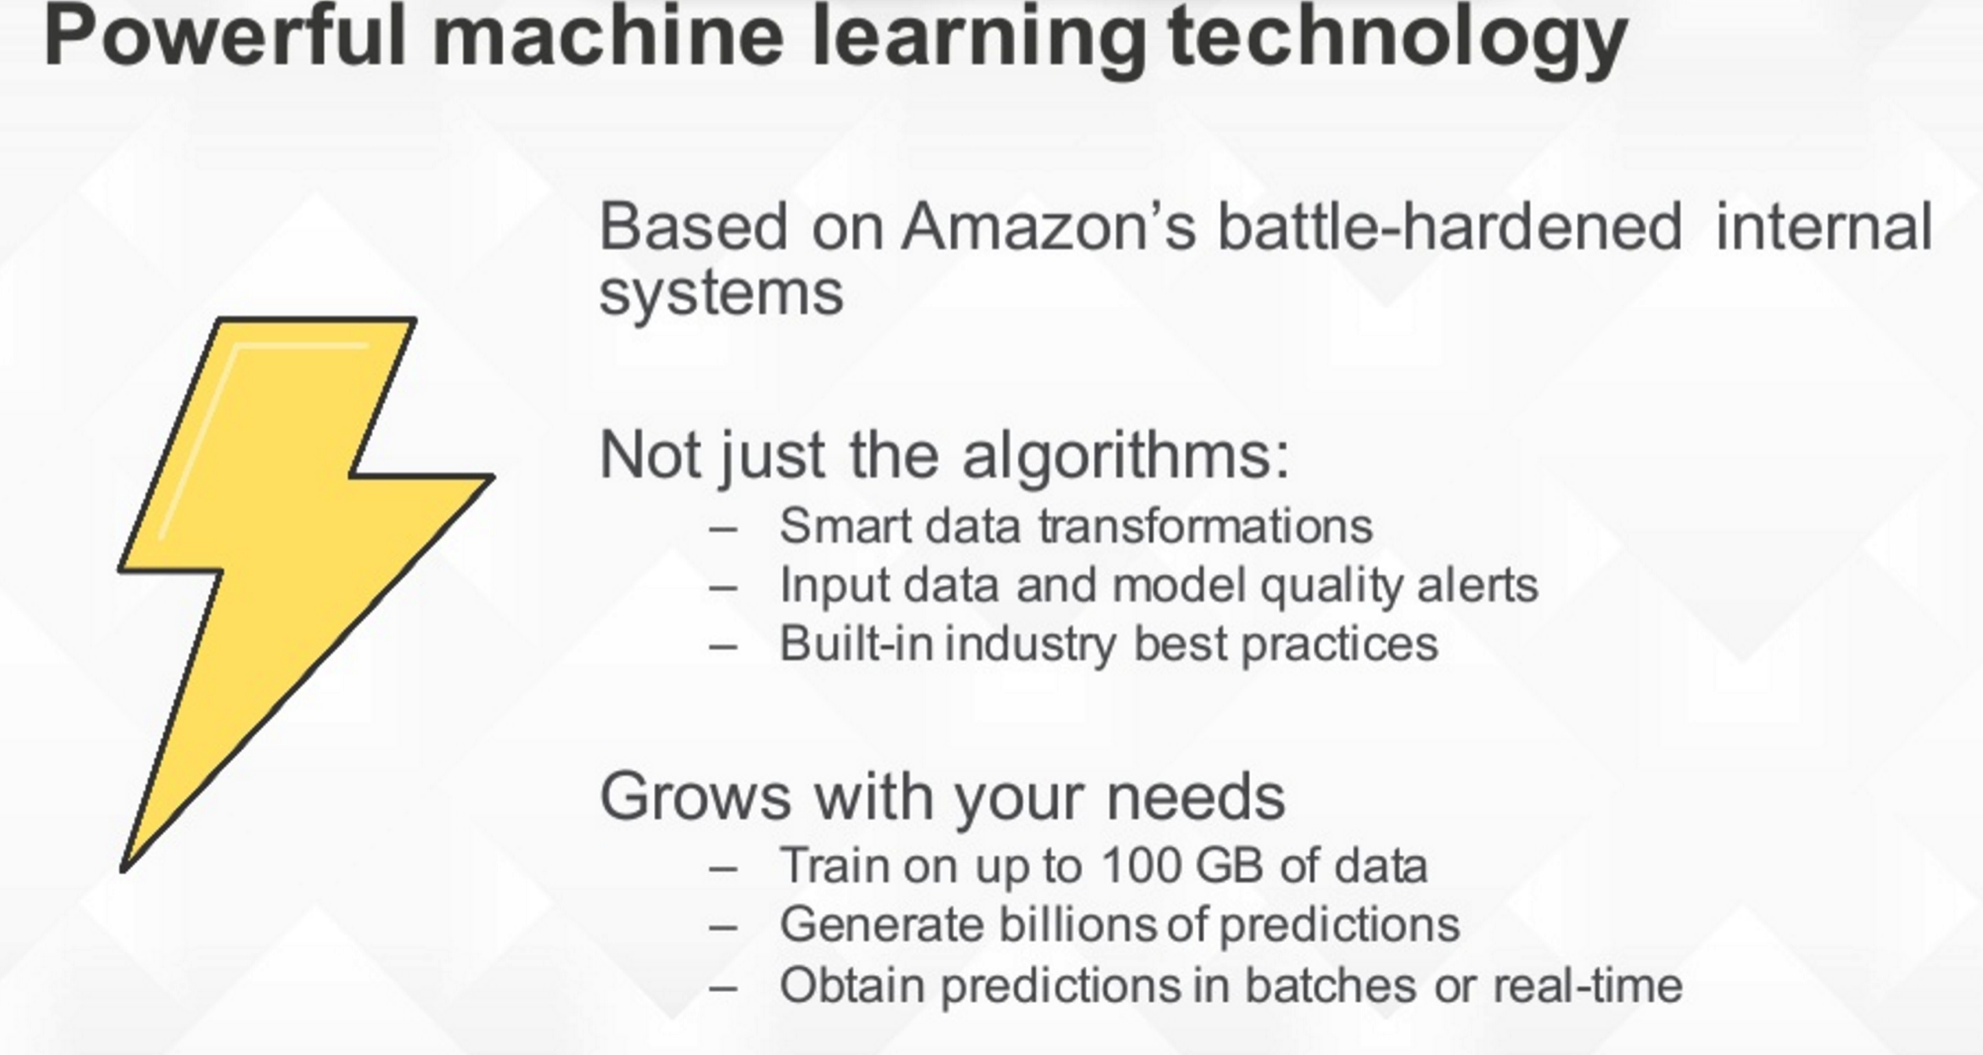
Amazon Machine Learning

Slide 33

Predictive Model Markup Language (PMML)
An XML language for sharing models from machine learning
Supported by R and other packages
Mahout has no support
Spark can export but not yet import
Scala only so far

Slide 34
Recap
Machine Learning is a powerful way of gaining insight and value from big data
Recommendation
Classification and prediction
Clustering and understanding
Many coding and deployment options
Built into Spark, Hadoop and AWS

Slide 35
Questions?

